Slide 1
Welcome to In Motion
Module One
Notes:
Could add the timeline for this module or facilitators names if you like!
This, and all slides in this deck are optional! Feel free to add slides for activities if that makes sense for you.

Slide 2


Morning Routine
For the first 30-minutes of our time together let’s slow down and settle in!
  Do you have coffee/tea/water? Feel free to grab some!
  Take some time to get comfortable in your space
  Have any good articles, memes, funny facts, or quotes to share with everyone? Feel free to share links in the chat!
Notes:
Page 24 in the In Motion Facilitator Guide. You could adapt this to suit your plan for the morning routine (i.e. using the chat to share or a Jamboard or just chatting) and share it just the first time, or every morning during the routine! Up to you and your group.

Slide 3

Land Acknowledgement
Notes:
Page 26 in the In Motion Facilitator Guide – Take time to do a land acknowledgement based on your area before starting class. You could also change the background picture to be from your area as well!

Slide 4
Would you describe yourself as a knapsack or a shopping bag?
Notes:
Icebreaker – Page 26 in the In Motion Facilitator Guide.
Feel free to switch up the comparisons on any of these slides with your own examples or others in the facilitator guide. How many you do depends on how much time you have.

Slide 5
Are you more like a superhighway or a meandering path through the forest?
Notes:
Icebreaker – Page 26 in the In Motion Facilitator Guide.

Slide 6
Do you feel more like a hot chili pepper or a hot fudge Sunday?
Notes:
Icebreaker – Page 26 in the In Motion Facilitator Guide.

Slide 7
Would you rather a vacation at the beach or in the mountains?
Notes:
Icebreaker – Page 26 in the In Motion Facilitator Guide.

Slide 8
Introductions
We’d love to know:
  Your name
  A fun fact about yourself that no one here knows
  What you hope to get out of the In Motion module (the first 3 weeks of IM&M+)
Notes:
Used for introductions – page 28 of the In Motion Facilitator Guide

Slide 9

Newton’s Laws of Motion
In the 1680s the English scientist Isaac Newton came up with three laws that describe motion.
In his first law, Newton explained that the motion of an object will not change unless a force pushes or pulls on the object.
In his second law, Newton showed that a strong force makes an object move faster than a weak force acting on the same object.
In Newton’s third law, he said that whenever a force pushes an object, the object pushes back with an equal and opposite force.
This Photo by Unknown Author is licensed under CC BY
Notes:
Newtons Law of Motion for when doing About This Series activity– page 29 of In Motion Workbook

Slide 10
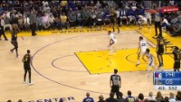
Example of Motion
Notes:
To supplement About This Series activity – page 30 of In Motion

Slide 11
Our Norms
  Insert norm here
  Insert norm here
  Insert norm here
  Insert norm here
  Insert norm here
  Insert norm here
  Insert norm here
  Insert norm here
  Insert norm here
Notes:
Norms brainstorm – page 33 in In Motion Facilitator Guide
There is a third column that will appear as you continue to go here. This could also be done on a Jamboard, whiteboard or a different medium of your choice! The most important thing is that you can refer back to them as a group anytime throughout the program.

Slide 12

You can have it all. Just not all at once.
Oprah Winfrey
Notes:
Talking point when doing debrief of Circle of Motion on page 38, if people have a lot that they want to change that's great, but can feel overwhelming, discuss momentum and going to fast – taking on too much change at once can make you crash.

Slide 13
Value Introductions
My name is ____________ and I value _________________.
Notes:
Used as a visual for Icebreaker on page 73

Slide 14
We will use our Power Boxes throughout all 3 modules of the IM&M+ program.
We can put things in our own boxes
Write messages for yourself… things that motivate and/or uplift you like quotes, videos or symbols
We can put things in others’ boxes
Leave messages of encouragement
Add items or pictures that have special meaning to you
Celebrate yourself by leaving messages or images that represent your strengths and gifts
Make note of moments you are most proud of
Share relatable, uplifting and/or funny quotes, and pictures
Leave messages describing the strengths and gifts you see in them
Describe things they said or did recently that impacted you and/or the group and why you are thankful for them
Notes:
Power Box Introductions – page 86 in the In Motion Facilitator Guide

Slide 15
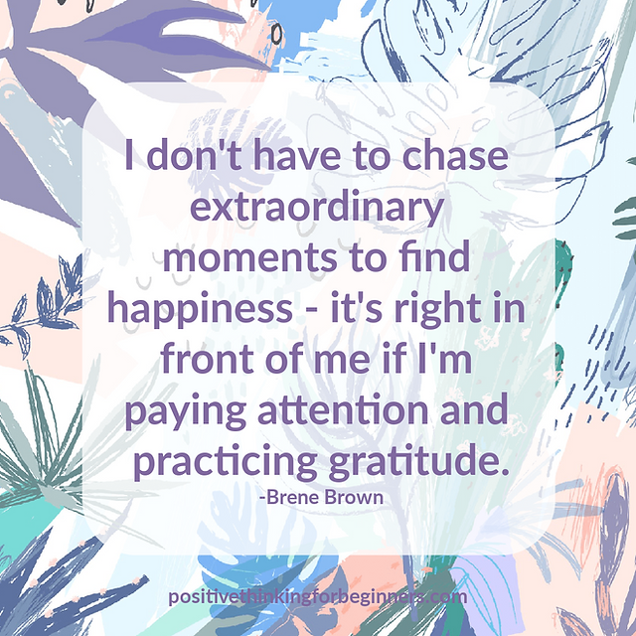
Sharing Circle
What is something from this week that you feel particularly good about? It could be:
  A strength that you have that has been affirmed for you
  An activity that was impactful that you really enjoyed?
  A person in the group who helped you
  Something you’ve overcome or a choice you made that you feel positive about – a step you feel proud of
  Or anything else that stands out!
Notes:
End of Day Check-In – Sharing circle questions on page 90 of the In Motion Facilitator Guide

Slide 16
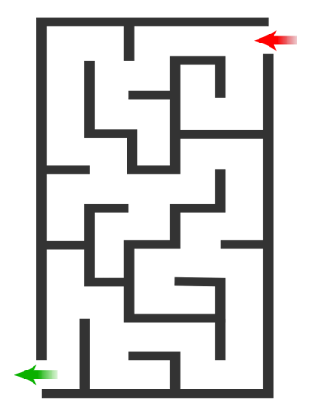

Notes:
Adding the Maze to the check-in – Page 94 in the In Motion Facilitator Guide
This is an empty maze option for the class maze – hidden slide at the end of this slideshow below explains how the maze could be done virtually on PowerPoint! If you do use this version of the maze for the class maze, you’ll be revisiting this slide every day.

Slide 17

Smart Goal
    Specific
    Measured
    Achievable
    Realistic
    Timed
Notes:
Smart goals – page 102 of In Motion Facilitator Guide

Slide 18


Who taught you?
My Mother
Compassion
When was the last time you used it?
Yesterday!
Motivating
Adaptability
Resilience
Competence
How did you learn it?
From moving a lot to new schools as a kid
JANE
Helping Hand
Notes:
Helping Hand Activity – Page 133
Jamboard is a great way to model this virtually as well

Slide 19
Sharing Circle
What is something from this week that you feel particularly good about? It could be:
  A strength that you have that has been affirmed for you
  An activity that was impactful that you really enjoyed?
  A person in the group who helped you
  Something you’ve overcome or a choice you made that you feel positive about – a step you feel proud of
  Or anything else that stands out!
Notes:
End of Day Check-In – Sharing circle questions on page 154 of the In Motion Facilitator Guide

Slide 20
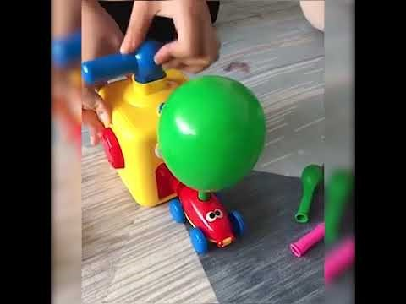
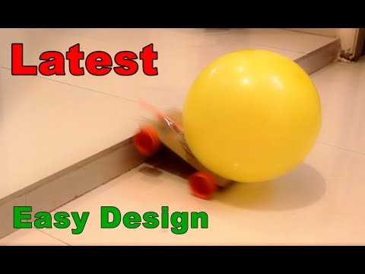
Balloon Powered Toy Car
Notes:
Return to the Balloon Activity – videos – page 161 of In Motion Facilitator Guide

Slide 21
Definition of an Inhibitor
An inhibitor is someone or something who makes you feel self-conscious and unable to act in a relaxed and natural way
They are things or people that may hold us back from building the energy we need to move forward to our goals
Notes:
Definition of an inhibitor to support Return to the Balloon activity on page 163 in the In Motion Facilitator Guide

Slide 22
Definition of Stress
Stress is the body’s response to any demand or pressure. It is a natural response. Stress can have healthy or unhealthy effects on our lives
Notes:
Definition of stress based on page 165 in the In Motion Facilitator Guide

Slide 23
Consider this…
As part of an experience at MIT people were asked to review a piece of paper with all kinds of letters and circle the double letters. They were given money to complete the task.
Group 1
Once a person had finished the researcher looked at the piece of paper, said, “well done” and placed the paper face down on the stack of other papers
Group 2
The researcher ignored what the person had done on the paper. They simply turn the paper over and put it in the pile
Group 3
The researcher doesn’t look at what they’ve done. They tear up the paper in front of them and throw it away
Notes:
Building meaningful rewards – visual for story about MIT experiment on Page 171 in In Motion Facilitator Guide
The question to discuss is: In all three groups, they were asked if they would like to complete the task again for less money. Which group do you think continued to do the task for the least amount of money?

Slide 24


Slide 25

Adaptability
The ability to achieve or adjust goals and behaviours when expected or unexpected change occurs, by planning, staying focused, persisting, and overcoming setbacks.

Slide 26

Collaboration
The ability to contribute and support others to achieve a common goal.

Slide 27
Communication
The ability to receive, understand, consider, and share information and ideas through speaking, listening, and interacting with others.

Slide 28

Creativity and Innovation
The ability to imagine, develop, express, encourage, and apply ideas in ways that are novel, unexpected, or challenge existing methods and norms.

Slide 29

Digital
The ability to use digital technology and tools to find, manage, apply, create, and share information and content.

Slide 30

Numeracy
The ability to find, understand, use, and report mathematical information presented through words, numbers, symbols, and graphics

Slide 31

Problem Solving
The ability to identify, analyze, propose solutions, and make decisions. Problem solving helps you to address issues, monitor success, and learn from the experience

Slide 32

Reading
The ability to find, understand, and use information presented through words, symbols, and images.

Slide 33

Writing
The ability to share information using written words, symbols, and images

Slide 34














Notes:
Hidden for facilitator reference only – here’s a completed maze a class did together using the insert icons option on word. The black icons represent the barriers and the green icons represent the chosen solutions. As time passes and the class shares barriers the maze fills up. The icons are chosen by the participant who is sharing their barrier.

