Slide 1
Welcome to Momentum
Module 2
Notes:
This, and all the slides in this deck are completely optional to use or adapt/add to for your delivery!

Slide 2


Morning Routine
For the first 30-minutes of our time together let’s slow down and settle in!
  Do you have coffee/tea/water? Feel free to grab some!
  Take some time to get comfortable in your space
  Have any good articles, memes, funny facts, or quotes to share with everyone? Feel free to share links in the chat!
Notes:
Page 14 in the Momentum Facilitator Guide. You could adapt this to suit your plan for the morning routine (i.e. using the chat to share or a Jamboard or just chatting) and share it just the first time, or every morning during the routine! Up to you and your group.

Slide 3

Land Acknowledgement
Notes:
Page 26 in the In Motion Facilitator Guide – Take time to do a land acknowledgement based on your area before starting class. You could also change the background picture to be from your area as well!

Slide 4

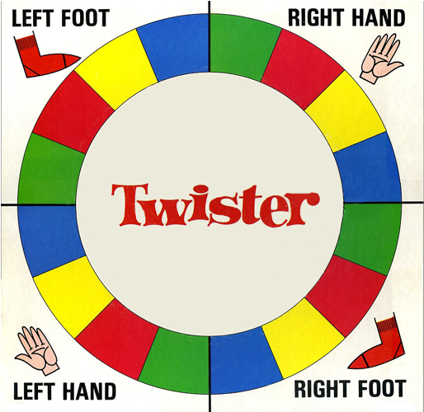
Twister Check In
Red = challenges / worries – that you are carrying into this new module
Green = change / learning – a change you've made since In Motion (module 1) that you are excited about
Yellow = supports / allies – some of the supports and allies you've connected with since In Motion
Blue = blue sky thinking / hopes for the future - what you hope to get out of this module
Notes:
Twister Check In – Page 16 of the Momentum Facilitator Guide – you will notice multiple versions of this slide. It’s because during each check in the questions associated with each colour change slightly to match what is happening that week in the module

Slide 5
Momentum Themes
  I AM
  Interests – what we like to do
  Values – what is important to us
  Motivators – what keeps us going
  I CAN
  Skills – what we can do
  Strengths – what we do well
  Supports – those things that can help us along the way
  I WANT
  Where I’d like to be
  What I’d like to be doing
  My preferred future
  I WILL
  My plan for getting some of the pieces of that life I want to live
Notes:
Momentum themes listed in the About Module 2 section on page 20 in the Momentum Facilitator Guide

Slide 6
Our Norms
  Insert norm here
  Insert norm here
  Insert norm here
  Insert norm here
  Insert norm here
  Insert norm here
  Insert norm here
  Insert norm here
  Insert norm here
Notes:
Page 32 in the Momentum Facilitator Guide
There is a third column that will appear as you continue to go here. This could also be done on a Jamboard, whiteboard or a different medium of your choice! The most important thing is that you can refer back to them as a group anytime throughout the program.

Slide 7




The 4C’s
Colour
Cuisine
Country
To visit
Closet Dream
Write down your favourite for each of the 4 C’s – keep them a secret!
Notes:
If you’re running virtually, you can get them to send them their 4 C’s privately in the chat so that you can read each of them out and they can guess who owns each one. This correspondes with the 4C’s icebreaker on page

Slide 8
Twister Check In
Red = challenges / worries – that you are carrying today
Green = change / learning – a change you are making this week
Yellow = supports / allies – people/things that you are thankful for
Blue = blue sky thinking / hopes for the future - what you hope you’ll get out of this week
Notes:
Twister Check In – Page 45 of the Momentum Facilitator Guide. You will notice multiple versions of this slide. It’s because during each check in the questions associated with each colour change slightly to match what is happening that week in the module

Slide 9

RESILIENCE
Resilience is the ability to become strong, healthy or successful again after something bad happens
Notes:
Resilient definition for I Am Resilient Activity on page 48

Slide 10










Attending a course
Moving
Doing a presentation
.
Notes:
Lifeline Activity on page 57 in the Momentum Facilitator Guide. This is an option for modeling with your own lifeline… using icons to represent different moments in your own life. (details are minimal so you can change them up and add your own, more detailed, examples. The stork represents the beginning (birth) of the life line and the present represented the present time… right now!

Slide 11

For Love or Money
Turn to page 26 in your workbook:
$ = something that cost more than $10 to do
A = something you prefer to do alone
P = something you need to plan in order to do
= something you’ve actually done in the last few weeks
Notes:
Key to have up for them while they fill in page 26 in their participant workbook. This us the Options and Opportunities: For the Love of it on page 69 in the Momentum Facilitator Guide

Slide 12
Twister Check In
Red = challenges / worries – that you are carrying
Green = change / learning – a change you are making
Yellow = supports / allies – people/things that you are thankful for
Blue = blue sky thinking / hopes for the future - what you hopeful for / looking forward to
Notes:
Twister Check In – Page 78 of the Momentum Facilitator Guide. You will notice multiple versions of this slide. It’s because during each check in the questions associated with each colour change slightly to match what is happening that week in the module

Slide 13















PREFERRED FUTURE / HOPES FOR THE FUTURE / BLUE SKY THINKING
THE STEPPING STONES REPRESENT THE STEPS WE TAKE TO TRAVEL UP THE RIVER
THE RIVER REPRESENTS OUR JOURNEY TO OUR PREFERRED FUTURE
BARRIERS / OBSTACLES
Notes:
Stepping Stones introduction on page 80 of the Momentum Facilitator Guide. A virtual option for introducing the Stepping Stores.

Slide 14




Enter your preferred future here
Last big step.
Fourth big step
Third big step
Second big step
First big step
Second Small Step
First Small Step
Notes:
If you’re going to model your own preferred future with them as they begin to build theirs – this is an option for putting together your model virtually. The big stones represent the big steps towards your goal and the small ones represent the small steps taken in between to get to each big step. Initially, only the big steps are mapped out.
This slide could also be duplicated and manipulated to be a class maze for the community project later in the module if the group agrees that they’d like to use this slide for the maze…this is just an option to consider and it’s up to the group as a whole!

Slide 15
Twister Check In
Red = challenges / worries – about moving forward with your preferred future
Green = change / learning – what you want to learn
Yellow = supports / allies – supports and allies you need to take the next step
Blue = blue sky thinking / hopes for the future - what you hopeful for / looking forward to
Notes:
Twister Check In – Page 78 of the Momentum Facilitator Guide. You will notice multiple versions of this slide. It’s because during each check in the questions associated with each colour change slightly to match what is happening that week in the module

Slide 16

Notes:
Guided Meditation – page 83 in the Momentum Facilitator Guide – This placeholder slide could be used anytime you are doing a meditation so that, especially on zoom, people don’t feel like everyone is looking at them with their eyes closed.

Slide 17



The Change Continuum
Where I’m headed now
If I do nothing, how bad can things get?
What would it look like I reached my goal?
Notes:
A visual you can share when doing The Change Continuum on page 102 of the Momentum Facilitator Guide. (they turn to page 33 in their workbook) If you want to show your own example you could also fill this out with your own situation and details for what outcomes for how things could go if you do nothing or if you reached your goal

Slide 18
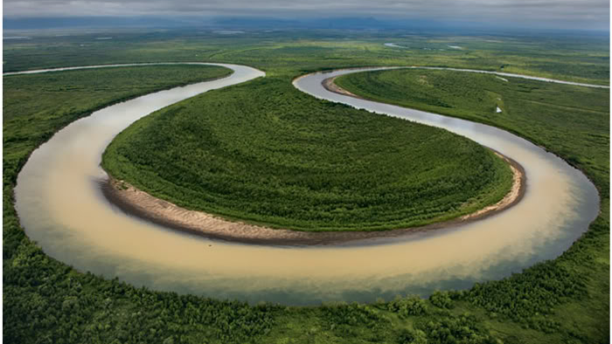
Notes:
The Spin Cycle activity on page 113 in the Momentum Facilitator Guide – this is a visual for the u-shaped bend of an oxbow that forms and creates a stagnant body of water (a place where the water gets “stuck”

Slide 19
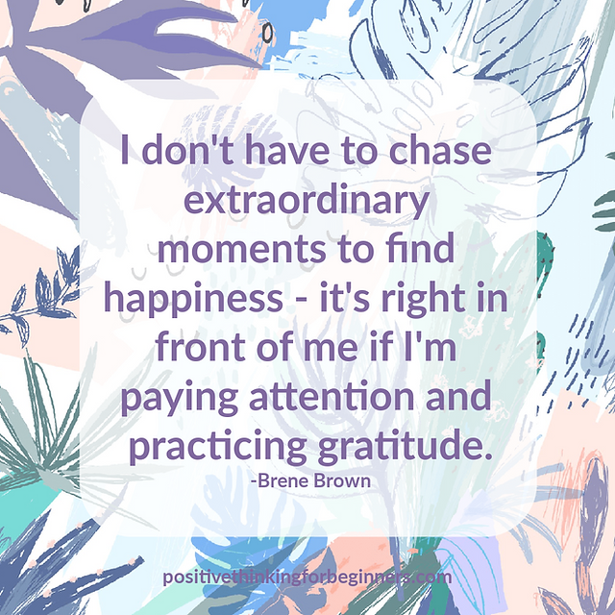
Sharing Circle
What is something from this week that you feel particularly good about? It could be:
  A strength that you have that has been affirmed for you
  An activity that was impactful that you really enjoyed?
  A person in the group who helped you
  Something you’ve overcome or a choice you made that feels like it moved you closer to your preferred future
  Or anything else that stands out!
Notes:
End of Day Check-In – Sharing circle questions on page 199 of the Momentum Facilitator Guide

Slide 20
Community Observation
In preparation for the community project planning starting next week, observe your community this weekend:
  What needs do you see around you?
  What needs do you have yourself that in the community might share?
  What do you see that feels wrong, frustrating or sad that – with a little effort – could be made a bit better?
  What assets do you see in the community?
  What are the gems in your community?
  What do you see that makes you smile and feel good?
  What opportunities do you see?
Notes:
Visual for the questions listed in the End of Day/Week Check-In on page 118 in the Momentum Facilitator Guide

Slide 21

Solution-Focused Strategies
Notes:
The following 4 slides after this one are visuals on solution-focused strategies that can be integrated into the Twister Check-In on Page 128 in the Momentum Facilitator guide. These strategies can be introduced during twister check-ins when discussing challenges.

Slide 22
Coping Strategies in Other Situations
This strategy puts the problem in perspective by exploring the times you’ve faced a similar challenge and over come it.
Coping Strategies in Other Situations Questions:
  Have you ever faced and overcome a similar challenge?
  Have you ever faced something like this in the past that you managed to cope with?
  What other situations have challenged you in any way like this? What did you do then?
Solution-Focused Strategies
Notes:
Solution- Focused Strategies Continued*

Slide 23
Exception Finder Questions
Are there times or even moments in a when you’re in a situation where the outlook was not so bleak and negative? This strategy can help find “positive cracks” where strengths can be recognized.
Exception Finder Questions:
  Are there times or moments when a problem is not so overwhelming?
  Is there any time in what you are facing when it doesn't feel so hopeless?
  Is there any time that you feel you are getting it? Enjoying it?
Solution-Focused Strategies
Notes:
Solution- Focused Strategies Continued*

Slide 24
Description of Between Session Changes
When an issue is ongoing overtime, this strategy can help you focus on the incremental (or big) positive changes and recognize progress.
Description of Between Session Changes Question:
  What happened since we last met that moved you even a little bit forward toward your goal/solution?
Solution-Focused Strategies
Notes:
Solution- Focused Strategies Continued*

Slide 25
Miracle Question
This strategy changes perspectives from looking to the past to looking to the future. Imagine that you have succeeded in achieving your goal – a miracle happened. This shift in focus can sometimes reveal hidden strengths and strategies that can point to new pathways to try.
Miracle Question:
  Imagine for a moment that all these difficulties are behind you and you have managed to overcome them... Now actually start to look back at what steps you had to take to get there?
Solution-Focused Strategies
Notes:
Solution- Focused Strategies Continued*

Slide 26
Twister Check In
Red = challenges / worries – use solution-focused strategies when discussing challenges!
Green = change / learning – what internal asset (skill, strength, knowledge or healthy attitude) are you most proud of right now
Yellow = supports / allies – what external asset do you most appreciate right now?
Blue = blue sky thinking / hopes for the future - what assets you’d most like to be able to use this week
Notes:
Twister Check In – Page 127 of the Momentum Facilitator Guide. You will notice multiple versions of this slide. It’s because during each check in the questions associated with each colour change slightly to match what is happening that week in the module

Slide 27
Stages of Group Development
Forming
  Team members tend to be polite and positive and excited about the project and the tasks ahead
Storming
  In this stage, people tend to push boundaries, different styles and preferences emerge, people may get frustrated if roles and task have not been clarified or have become unclear
Norming
  People start to resolve their differences, appreciate individual members strengths and respect each other. People start to bond and develop a stronger commitment to the team’s goal and progressing towards it
Performing
  A group starts working hard towards the goal using strategies to problem solve and norms are implemented. The group has found their stride.
Performing
Norming
Storming
Forming
Notes:
Stages of Group Development, discussed in the debrief of the Bag Tie Blitz on page 151 in the Momentum Facilitator Guide

Slide 28




Stages of Group Development
Where do you think our group is right now?
Performing
On zoom, use the Celebration reaction
Norming
On zoom, use the Heart reaction
Performing
Storming
Norming
On zoom, use the Surprised Face reaction
Forming
Storming
On zoom, use the Thumbs Up reaction
Forming
Notes:
Option for assessing where the group thinks they are on zoom when discussing stages of group development (page 154)

Slide 29
Twister Check In
Red = challenges / worries – use solution-focused strategies when discussing challenges!
Green = change / learning – what internal asset (skill, strength, knowledge or healthy attitude) you especially want to bring to the group today – or practice and improve this week
Yellow = supports / allies – how you want to support other group members today – or the kind of support you could really benefit from today
Blue = blue sky thinking / hopes for the future - your hopes or intent for the group this week
Notes:
Twister Check In – Page 155 of the Momentum Facilitator Guide. Revisit the Solution-Focused Strategies on the slides above if that would be helpful for you and the group!
You will notice multiple versions of this slide. It’s because during each check in the questions associated with each colour change slightly to match what is happening that week in the module

Slide 30

Qualities of a Leader – Quotes
A leader is someone who knows the way, goes the way, and shows the way
John C. Maxwell
It is better to lead from behind and to put others in front, especially when you celebrate victory when nice thing happen
Nelson Mandela
To handle yourself, use your head; to handle others, use your heart
Eleanor Roosevelt
Notes:
Some quotes from the text in the Momentum Facilitator Guide to go along with the Qualities of a Leader Icebreaker on page 171

Slide 31

Smart Goal
    Specific
    Measured
    Achievable
    Realistic
    Timed
Notes:
Smart goal revisited during Stepping Stones: Our Community Project in page 178 in the Momentum Facilitator Guide

Slide 32
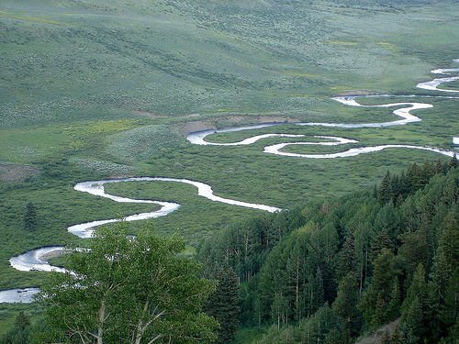
This Photo by Unknown Author is licensed under CC BY-NC-ND
Notes:
Image of a “meandering river” to go along with Stepping Stones: Our Community project on page 178 in the Momentum Facilitator Guide

Slide 33
Twister Check In
Red = challenges / worries – A worry you have about the community project (use solution-focused strategies)
Green = change / learning – a skill you bring to the community project
Yellow = supports / allies – a way you think you can support the whole group or particular group members during the project next week
Blue = blue sky thinking / hopes for the future - one thing you especially want to get our of doing the community project
Notes:
Twister Check In – Page 192 of the Momentum Facilitator Guide. Revisit the Solution-Focused Strategies on the slides above if that would be helpful for you and the group!
You will notice multiple versions of this slide. It’s because during each check in the questions associated with each colour change slightly to match what is happening that week in the module

Slide 34
Sharing Circle
What is something from this week that you feel particularly good about? It could be:
  Something you’re really excited about doing as part of the community project
  A strength that you have that has been affirmed for you
  An activity that was impactful that you really enjoyed?
  A person in the group who helped you
  Something you’ve overcome or a choice you made that feels like it moved you closer to your preferred future
Notes:
End of Day Check-In – Sharing circle questions on page 199 of the Momentum Facilitator Guide

Slide 35

Community Project Week!!
Notes:
Placeholder slide for the beginning of week 3, which starts on page 201 in the Momentum Facilitator Guide

Slide 36
Twister Check In
Red = challenges / worries – about the project or a project task that you are undertaking
Green = change / learning – the strategies that you hope to use or the skills/learning you hope to get from today
Yellow = supports / allies – that you will access in order to complete your tasks
Blue = blue sky thinking / hopes for the future - what you hope to achieve during the day
Notes:
Twister Check In – Page 206 of the Momentum Facilitator Guide. This version of the twister check in can be used each day of the community project week.
Revisit the Solution-Focused Strategies on the slides above if that would be helpful for you and the group!
You will notice multiple versions of this slide. It’s because during each check in the questions associated with each colour change slightly to match what is happening that week in the module

Slide 37

Pride Stories
Take a moment to reflect on and share:
  One thing that happened today that you are excited about, you thought went well, or you are proud of
  One thing you learned today
Notes:
Pride stories and end of day check-in for the end of each day of Community Project Week (different questions for the last day/end of the week on next slide) on page 212, 223 in the Momentum Facilitator Guide

Slide 38

End of Community Project Pride Stories
Take a moment to reflect on and share:
  What are you most proud of that you accomplished this week?
  Anything else you want to share about this week!
Notes:
Celebrating A Milestone: Learnings from the Community Project – final check in sharing circle page 234 in the Momentum Facilitator Guide

Slide 39
Twister Check In
Red = challenges / worries – about the community project now that it is complete
Green = change / learning – the strategies you used or the skills/learning you developed
Yellow = supports / allies – the supports and allies that you accessed during the project
Blue = blue sky thinking / hopes for the future - what you hope is a result of the project or what they hope is another project that happens as a result of the project
Notes:
Twister Check In – Page 238 of the Momentum Facilitator Guide. Revisit the Solution-Focused Strategies on the slides above if that would be helpful for you and the group!
You will notice multiple versions of this slide. It’s because during each check in the questions associated with each colour change slightly to match what is happening that week in the module

Slide 40

My SELF After the Community Project
  What is one things that has changed for you since completing the project
  What is one thing you feel good about contributing to the project?
Notes:
Questions to discuss during the debrief of My SELF After the Community Project on page 245 in the Momentum Facilitator Guide

Slide 41
Action Plan - Reworked
  What is a key change or addition you've made to your action plan that happened as a result of your participation in the community project?
  How do you feel about taking the first step of your action plan? Are you excited? Nervous? Worried?
Notes:
Reflection questions to do in plenary once they have revisited their action plans on page 255 in the Momentum Facilitator Guide

Slide 42
Twister Check In
Red = challenges / worries – about getting started on your action plan
Green = change / learning – the strategies you hope to use or the skills/learning you hope to build that will support you in getting started
Yellow = supports / allies – the supports and allies that will encourage you to get moving
Blue = blue sky thinking / hopes for the future - what you hope to achieve in the next two weeks
Notes:
Twister Check In – Page 259 of the Momentum Facilitator Guide. Revisit the Solution-Focused Strategies on the slides above if that would be helpful for you and the group!
You will notice multiple versions of this slide. It’s because during each check in the questions associated with each colour change slightly to match what is happening that week in the module

Slide 43

How much fuel is taken up on launch?
10%
20%
50%
75%
100%
Notes:
Question for them to guess the answer to in the beginning of the Pay Off Matrix activity on page 262 in the Momentum Facilitator Guide
This slide includes an animation, the answer will not be highlighted initially, only when you click will the answer become highlighted when you are viewing the slideshow in presentation mode.

Slide 44
“Somehow, I can’t believe that there are any heights that can’t be scaled by a person who knows the secrets of making dreams come true. This special secret, it seems to me, can be summarized in four C’s. They are curiosity, confidence, courage, and constancy, and the greatest of all is confidence. When you believe in a thing, believe in it all the way, implicitly and unquestionable.”
– Walt Disney
Notes:
Walt Disney quote visual for the beginning of the 4Cs Redux on page 266 in the Momentum Facilitator Guide

Slide 45
4 C’s Defined
  Curiosity: a strong desire to know or learn something
  Confidence: feeling of trust in your own abilities, qualities and judgement
  Courage: mental or moral strength to venture, persevere, and withstand danger, dear or difficulty
  Constancy: the quality of being faithful and dependable
Notes:
Definition of the 4 C’s for the 4 C’s Redux activity on page 266 in Momentum Facilitator Guide

Slide 46
The Last Twister Check In of Momentum
Red = challenges / worries – about the next steps as you transition to Momentum+
Green = change / learning – the strategies you will use when you face a challenge
Yellow = supports / allies – your motivators that will keep you moving
Blue = blue sky thinking / hopes for the future - your hopes for yourself and the members of the group
Notes:
Twister Check In – Page 279 of the Momentum Facilitator Guide. Revisit the Solution-Focused Strategies on the slides above if that would be helpful for you and the group!
You will notice multiple versions of this slide. It’s because during each check in the questions associated with each colour change slightly to match what is happening that week in the module

Slide 47
We will use our Power Boxes throughout all 3 modules of the IM&M+ program.
We can put things in our own boxes
Write messages for yourself… things that motivate and/or uplift you like quotes, videos or symbols
We can put things in others’ boxes
Leave messages of encouragement
Add items or pictures that have special meaning to you
Celebrate yourself by leaving messages or images that represent your strengths and gifts
Make note of moments you are most proud of
Share relatable, uplifting and/or funny quotes, and pictures
Leave messages describing the strengths and gifts you see in them
Describe things they said or did recently that impacted you and/or the group and why you are thankful for them
Notes:
Anytime you fit in some PowerBox time at the end of the day you can throw up this slide to give some ideas about what folks could put in their boxes and others boxes

