Slide 1
Welcome to Momentum+
Module 3
Notes:
This, and all the slides in are optional and can be adapted/added to for your delivery of the Momentum+ module.
These slides are for the planned activities in the Momentum+ Facilitator Guide on day 1 & 5 and the reoccurring ones that happen on all of the other Momentum+ days (morning routine & twister check in)

Slide 2


Morning Routine
For the first 30-minutes of our time together let’s slow down and settle in!
  Do you have coffee/tea/water? Feel free to grab some!
  Take some time to get comfortable in your space
  Have any good articles, memes, funny facts, or quotes to share with everyone? Feel free to share links in the chat!
Notes:
Page 14 in the Momentum Facilitator Guide. You could adapt this to suit your plan for the morning routine (i.e. using the chat to share or a Jamboard or just chatting) and share it just the first time, or every morning during the routine! Up to you and your group.

Slide 3

Land Acknowledgement
Notes:
Page 26 in the In Motion Facilitator Guide – Take time to do a land acknowledgement based on your area before starting class. You could also change the background picture to be from your area as well!

Slide 4
Our Norms
  Insert norm here
  Insert norm here
  Insert norm here
  Insert norm here
  Insert norm here
  Insert norm here
  Insert norm here
  Insert norm here
  Insert norm here
Notes:
Page 15 in the Momentum+ Facilitator Guide – ahead of time, if you used a slide, update this to be the norms they had already from Momentum. If you didn’t use a slide – go to whatever medium you’ve been using for norms so far!
There is a third column that will appear as you continue to go here. This could also be done on a Jamboard, whiteboard or a different medium of your choice! The most important thing is that you can refer back to them as a group anytime throughout the program.

Slide 5

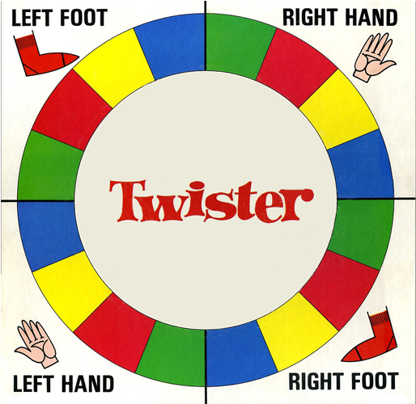
Twister Check In
Red = challenges / worries – that you are carrying into this workshop
Green = change / learning – a change you've made since Momentum (module 2) that you are excited about
Yellow = supports / allies – some of the supports and allies you've connected with since Momentum
Blue = blue sky thinking / hopes for the future - what you hope to get out of this module
Notes:
Momentum+ Day 1 Twister Check In – Page 22 of the Momentum+ Facilitator Guide – you will notice multiple versions of this slide. It’s because during each check in the questions associated with each colour change slightly to match what is happening that week in the module

Slide 6
Purpose and Goals of Momentum+
  To provide supports, encouragement and motivation to implement our Action Plan and achieve our identified goals
  To help us maintain and tap into the positive support systems we've created throughout the program and provide us with opportunities to expand our support networks
  To provide opportunities to learn about community resources that can support us with the actions we want to take
  To help us to stay connected and supporting each other as a group
Notes:
Introducing Momentum+ - page 24 of the Momentum+ Facilitator Guide

Slide 7
Momentum+ Schedule
Insert your momentum+ schedule here with dates and times of workshops to review with everyone
Notes:
Introducing Momentum+ on page 24 of the Momentum+ Facilitator Guide

Slide 8
We will use our Power Boxes throughout all 3 modules of the IM&M+ program.
We can put things in our own boxes
Write messages for yourself… things that motivate and/or uplift you like quotes, videos or symbols
We can put things in others’ boxes
Leave messages of encouragement
Add items or pictures that have special meaning to you
Celebrate yourself by leaving messages or images that represent your strengths and gifts
Make note of moments you are most proud of
Share relatable, uplifting and/or funny quotes, and pictures
Leave messages describing the strengths and gifts you see in them
Describe things they said or did recently that impacted you and/or the group and why you are thankful for them
Notes:
Reconnecting with your Power Boxes – Page 32 of the Momentum+ Facilitator Guide

Slide 9
Twister Check In
Red = challenges / worries – that you have about taking the next step in your action plan (or challenges / worries you want support that aren’t related to your action plan)
Green = change / learning – a change you've made since we last met that you are excited about
Yellow = supports / allies – some of the supports and allies you've connected with since we last met
Blue = blue sky thinking / hopes for the future - any hopes you have for yourself, others or todays workshop
Notes:
Momentum+ Day 2, 3, & 4 Twister Check In – Page 22 of the Momentum+ Facilitator Guide – you will notice multiple versions of this slide. It’s because during each check in the questions associated with each colour change slightly to match what is happening that week in the module

Slide 10
Sustaining and Activating Our Connections
Momentum+ Day 5
Notes:
The following slides are for the day 5 workshop starting on page 39 of the Momentum+ Facilitator Guide

Slide 11
Twister Check In
Red = challenges / worries – about taking the next steps / the end of the program
Green = change / learning – strategies or you will use to sustain your motivation and support networks
Yellow = supports / allies – that you will sustain and grow that will encourage you to keep moving forward
Blue = blue sky thinking / hopes for the future - what you hope for yourself and/or the group as you move forward from the program,
Notes:
Momentum+ Day 5 Twister Check In – Momentum+ Facilitator Guide – you will notice multiple versions of this slide. It’s because during each check in the questions associated with each colour change slightly to match what is happening that week in the module

Slide 12
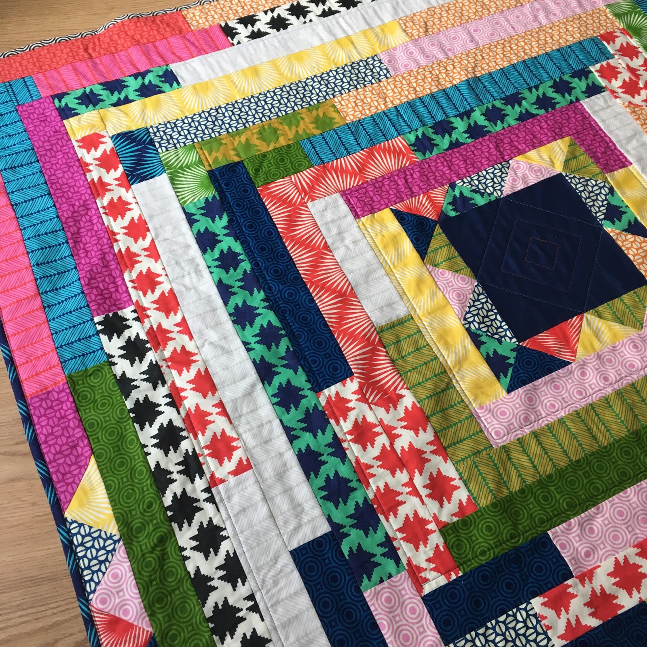
Our IM&M+ Quilt
Decorate your quilt to represent an aspect of who you are today as a result of what you learned about yourself in the IM&M+ program. Things you may want to include:
  My strengths and skills
  What makes me resilient
  What motivates me (keeps me moving forward)
  What others like/admire/ appreciate about me
  My growing sense of self-esteem
  My vision and hope for my future
This Photo by Unknown Author is licensed under CC BY-NC-ND
Notes:
Outline of examples of what each square on their quilt could mean. From Creating a Quilt of Belonging on page 49 in the Momentum+ Facilitator Guide

Slide 13
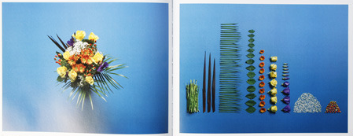

There is a principle in philosophy (Aristotle) that says, "the whole is greater than the sum of its parts."
  Psychologists apply this principle to group dynamics. You may have heard the word synergy. It means: the combined power of a group is greater than the total power achieved by each person working separately.
Notes:
Visual for the debrief of the quilt activity on page 51 of the Momentum+ Facilitator Guide

Slide 14
Power Box Wish
Remember to bring your power box next week and have a power box wish for each person in the group.
  Over the next week think of what might motivate and inspire each person in the next step of their journey. Write and note and/or bring a small “gift” for each group member (i.e., a quote, poem, picture or drawing)
Notes:
Visual for Power Box request as part of Planning Week 6 activity on page 72 of the Momentum+ Facilitator Guide

Slide 15
We will use our Power Boxes throughout all 3 modules of the IM&M+ program.
We can put things in our own boxes
Write messages for yourself… things that motivate and/or uplift you like quotes, videos or symbols
We can put things in others’ boxes
Leave messages of encouragement
Add items or pictures that have special meaning to you
Celebrate yourself by leaving messages or images that represent your strengths and gifts
Make note of moments you are most proud of
Share relatable, uplifting and/or funny quotes, and pictures
Leave messages describing the strengths and gifts you see in them
Describe things they said or did recently that impacted you and/or the group and why you are thankful for them
Notes:
Some inspiration/ideas to put up during Power Box time at end of the day – page 74 of the Momentum+ Facilitator Guide.

Slide 16
The Last
Twister Check In
Red = challenges / worries – about taking the next steps / the end of the program
Green = change / learning – strategies or you will use to sustain your motivation and support networks
Yellow = supports / allies – that you will sustain and grow that will encourage you to keep moving forward
Blue = blue sky thinking / hopes for the future - what you hope for yourself and/or the group as you move forward from the program,
Notes:
Momentum+ Day 6 (last day) Twister Check In – Momentum+ Facilitator Guide – you will notice multiple versions of this slide. It’s because during each check in the questions associated with each colour change slightly to match what is happening that week in the module

